Slide 1
TSI 2022
LEKCIJA 1: RDBMS & SQL

Slide 2
KONTAKT
Dejan Radeljic
dejan@bildbosnia.org
Materijali
www.mozemo.ba/db

Slide 3
BAZE PODATAKA
Sta su to baze podataka i koji problem nam rjesavaju?

Slide 4
BAZE PODATAKA
Strukturisan set podataka pohranjen na racunaru.
Baza podataka - kolekcija medjusobno povezanih podataka.
Podaci - kolekcija cinjenica koje mozemo procesirati ili obraditi na neki nacin da dobijemo informacije.

Slide 5
BAZE PODATAKA
Ono sto ne vidimo - prava moc baza podataka.
Security, integrity, robustness, fast & reliable access to data…
Razliciti tipovi baza podataka - nas interesuju relacione baze podataka.

Slide 6
RELACIONE BAZE PODATAKA
Relaciona DB - baza zasnovana na relational modelu podataka.
Relational model - podaci organizovani u jednu ili vise tabela (kolona i redova) u kojoj svaki red ima jedinistveni kljuc za identifikaciju.
Jedna tabela - jedan entity (customer, product, etc.)
Jedan red - instanca entitya, jedna kolona - atribut instance.

Slide 7
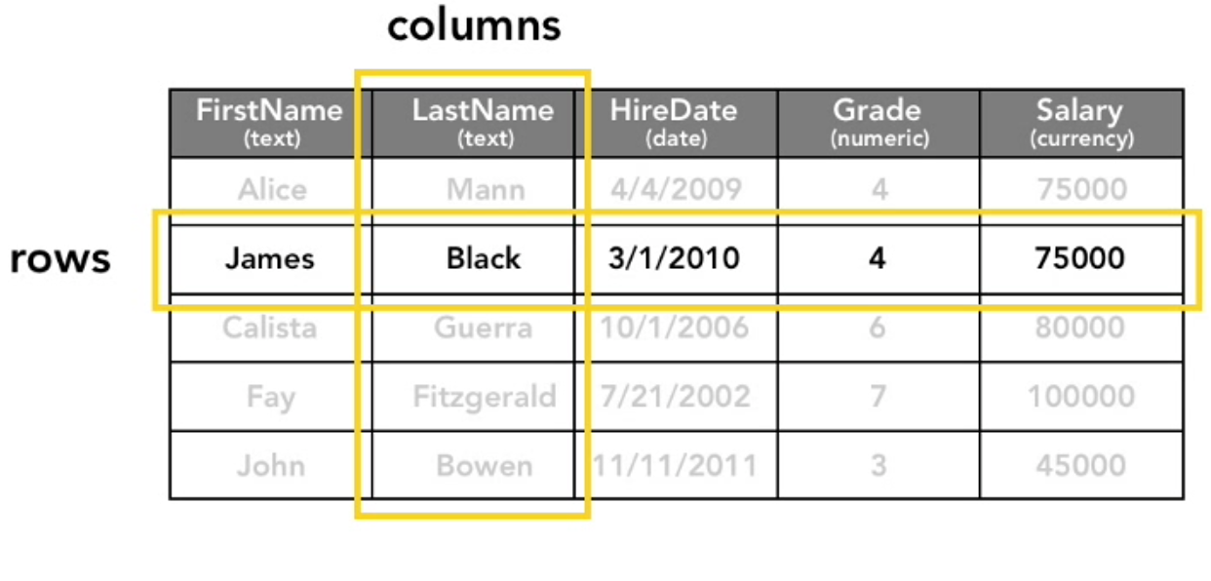
RELACIONE BAZE PODATAKA

Slide 8
RELACIONE BAZE PODATAKA
Jako bitan koncept - kljucevi.
Kljuc - mehanizam za identifikovanje specificnog reda podataka.
Primary key (PK), foreign key (FK).

Slide 9
RELACIONE BAZE PODATAKA
Relacije u relacionim bazama - utemeljene na kljucevima.
Tipovi relacija (cardinalities):
One-to-many
Many-to-many
One-to-one
No cardinality

Slide 10
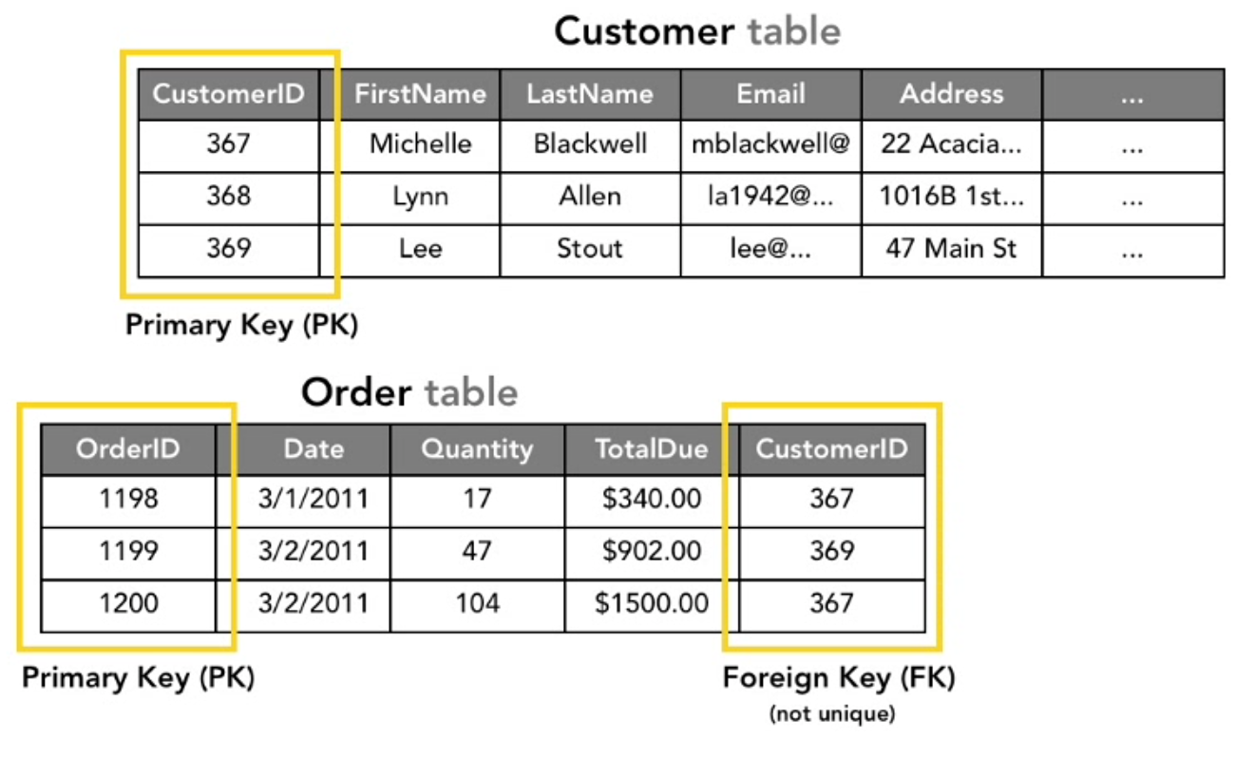
RELACIONE BAZE PODATAKA

Slide 11
RELACIONE BAZE PODATAKA
Bitna razlika: DB != (R)DBMS.
Baza podataka (DB): podaci + pravila.
(R)DBMS: software koji nam omogucava kreiranja i management baza.

Slide 12
MySQL
Open source RDBMS koji cemo da koristimo.
Medju najpopularnijim RDBMBSovima danasnjice.
MySQL Workbench

Slide 13
SQL
SQL - Structured Query Language
SQL koristimo da opisemo sta zelimo, (R)DBMS odradi sve ostalo.
SQL nam omogucava (S)CRUD operacije u nasim aplikacijama.

Slide 14
SQL CRUD
S - search - ne postoji poseban clause za search.
C reate (INSERT) R read (SELECT) U pdate (UPDATE) D delete (DELETE)

Slide 15
SQL PODJELA
SQL podijeljen na 2 kategorije:
DML (Data Manipulation Language)
DDL (Data Definition Language)
Fancy nacin da kategorisemo razne SQL izjave.

Slide 16
DATA MANIPULATION LANGUAGE
Omogucava nam pristup i manipulaciju podacima u
postojecim bazama.
DELETE, INSERT, MERGE, SELECT, UPDATE...

Slide 17
DATA DEFINITION LANGUAGE
Omogucava nam kreiranje podataka u bazama, kao i
samih baza.
CREATE, ALTER, DROP ....

Slide 18
CREATE DATABASE
CREATE DATABASE dbName;
CREATE SCHEMA schemaName;

Slide 19
CREATE TABLE
CREATE TABLE students (
id INTEGER,
name TEXT,
lastName TEXT,
email TEXT
);

Slide 20
INSERT INTO
INSERT INTO students VALUES (1, 'dejan', 'radeljic', 'dejan@bildbosnia.org');
INSERT INTO students VALUES (2, 'user', 'name', 'user@name.com');
INSERT INTO students VALUES (3, 'another', 'one', 'another@one.com');
SELECT * FROM students;

Slide 21
INSERT INTO
INSERT INTO students (name, lastName) VALUES ('johnny', 'boy');
SELECT * FROM students;
NULL - no value here

Slide 22
ZADATAK
Kreirati novu bazu podataka, novu tabelu te ispuniti istu nekim podacima.
Ime baze, ime tabele, podaci u tabeli - po zelji.

Slide 23
INSERT INTO
CREATE TABLE info (
id INTEGER,
name TEXT,
email TEXT
);
INSERT INTO info VALUES (5, 'user', 'user@name.com');

Slide 24
INSERT INTO
INSERT INTO test (A, B, C) SELECT id, name, email FROM info;
SELECT * FROM test;

Slide 25
DELETE FROM
SELECT * FROM students WHERE id = 1;
DELETE FROM students WHERE id = 1;
SELECT * FROM students;
Notes:
SET SQL_SAFE_UPDATES = 0;

Slide 26
NULL
SELECT * FROM students WHERE id = NULL;
SELECT * FROM students WHERE id IS NULL;
SELECT * FROM students WHERE id IS NOT NULL;
INSERT INTO students (id, name, lastName) VALUES (0 , NULL, '');
SELECT * FROM students;

Slide 27
NOT NULL CONSTRAINT
CREATE TABLE notNULL (
a INTEGER NOT NULL,
b TEXT NOT NULL,
c TEXT
);
INSERT INTO notNULL VALUES (1, 'this', 'that');

Slide 28
NOT NULL CONSTRAINT
SELECT * FROM notNULL;
INSERT INTO notNULL (b, c) VALUES ('other', 'other');

Slide 29

DROP TABLE
DROP TABLE notNULL;
DROP TABLE IF EXISTS notNULL;

Slide 30
DEFAULT CONSTRAINT
CREATE TABLE notNULL (
a INTEGER NOT NULL DEFAULT 9,
b TEXT NOT NULL,
c TEXT
);
INSERT INTO notNULL (b, c) VALUES ('SUCH', 'SQL');

Slide 31
UNIQUE CONSTRAINT
DROP TABLE IF EXISTS test;
CREATE TABLE test (
a TEXT,
b TEXT,
c INT UNIQUE
);
INSERT INTO test (a, b, c) VALUES ('SUCH', 'SQL', 9); x2

Slide 32
UNIQUE CONSTRAINT
INSERT INTO test (a, b, c) VALUES ('SUCH', 'SQL', NULL);
INSERT INTO test (a, b, c) VALUES ('SUCH', 'SQL', NULL);
SELECT * FROM test;

Slide 33
ZADATAK
Kreirati novu bazu podataka (tsi) kao i tabelu students.
Kolona id unutar tabele students - ne smije biti NULL.
Kolona email unutar tabele students - ne smije sadržavati duplikate.

Slide 34
ALTER TABLE
CREATE TABLE test (
a TEXT,
b TEXT,
c TEXT
);
INSERT INTO test VALUES ('one', 'two', 'three');

Slide 35
ALTER TABLE
ALTER TABLE test ADD d TEXT;
SELECT * FROM test;
ALTER TABLE test ADD e INT DEFAULT 9;
SELECT * FROM test;

Slide 36
UPDATE
UPDATE test SET d = 'not null' WHERE a = 'one';
SELECT * FROM test;

Slide 37
PRIMARY KEY CONSTRAINT
CREATE TABLE test (
id INTEGER PRIMARY KEY AUTO_INCREMENT,
a INTEGER,
b TEXT
);
INSERT INTO test (a , b) VALUES (10, 'a'); x3

Slide 38
ZADATAK
Kreirati novu bazu podataka (tsi) kao i tabelu students.
Kolona id unutar tabele students - primary key, auto incremented.
Kolona email unutar tabele students - ne smije sadržavati duplikate.
Dodati kolone za broj telefona, datum rodjenja, grad u kojem student živi. Koristiti smislene constrainte.

Slide 39
WORLD DATABASE
Korisna test baza koju mozete koristiti za vjezbu.
Kreirati world bazu. Importovati world.sql
Go forth and play.

Slide 40
FILTERING INFORMATION
SELECT * FROM Country - jako sirok, beskoristan query.
SELECT Name, Continent, Population FROM Country WHERE Population < 100000 ORDER BY Population DESC;
SELECT Name, Continent, Population FROM Country WHERE Population < 100000 AND Population > 50000 ORDER BY Population DESC;

Slide 41
FILTERING INFORMATION
SELECT Name, Continent, Population FROM Country WHERE Population < 100000 AND Continent = 'Oceania'
SELECT Name, Continent, Population FROM Country WHERE Name LIKE '%island%' ORDER BY Name;
SELECT Name, Continent, Population FROM Country WHERE Name LIKE '_a%' ORDER BY Name;

Slide 42
FILTERING INFORMATION
SELECT Name, Continent, Population FROM Country WHERE Continent
IN ('Europe', 'Asia') ORDER BY Name;
SELECT Continent FROM Country;
SELECT DISTINCT Continent FROM Country;

Slide 43
FILTERING INFORMATION
SELECT Name, LifeExpectancy AS 'Life Expectancy' FROM Country ORDER BY Name;
SELECT COUNT(*) FROM Country;
SELECT COUNT(LifeExpectancy) FROM Country;
SELECT COUNT(*) FROM Country WHERE Population > 1000000;

Slide 44
FILTERING INFORMATION
SELECT Name, Continent, Region FROM Country WHERE Continent =
'Europe' LIMIT 5;

